Slide 1
about:OBS
Conference/event name
Location
name
openSUSE Ambassador
name@opensuse.org

Slide 2
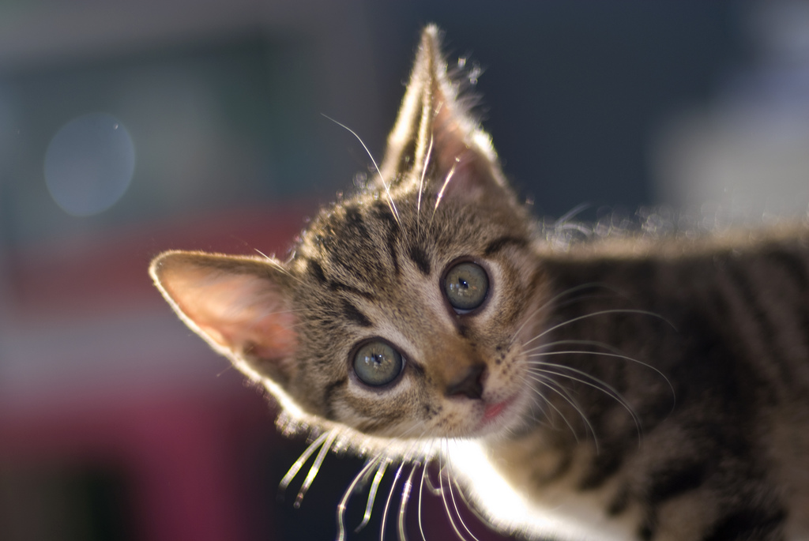
Me
Notes:
about yourself!

Slide 3
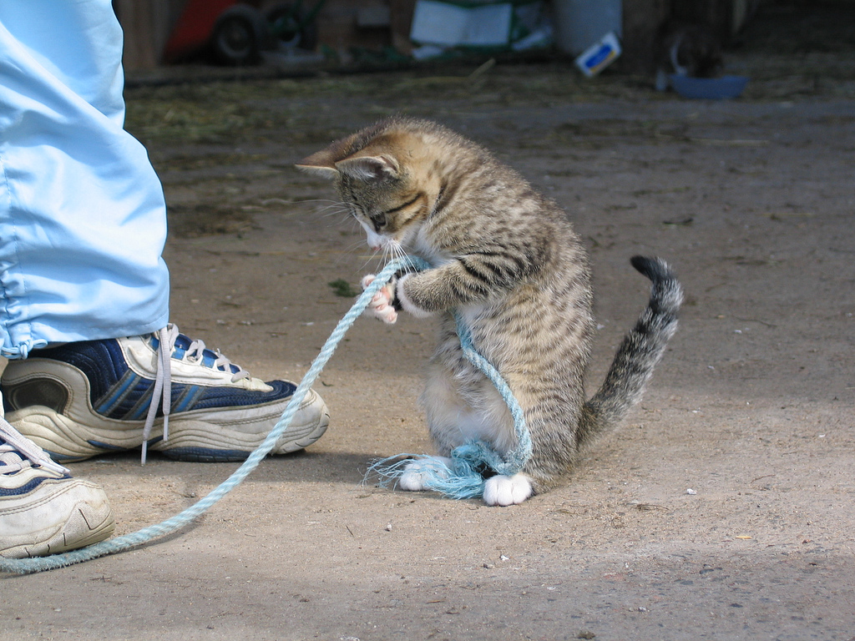
Hard work
Notes:
Build Service
The problem to solve: As developer you write software. How to get the product to many linux distro's and even other platforms?
Not an issue for established projects like Gimp or KDE but it is for new applications!

Slide 4

OBS...
Free
on
build.opensuse.org
120.000
users
packages
27.000
21
6
distributions
architectures
Notes:
Build.opensuse.org currently builds more than 120.000 packages by almost 30.000 developers for 21 operating systems and 6 architectures. Yes, that includes the latest releases of debian and fedora, 32 and 64 bit and arm; we even have experimental windows support.
Sponsored by Novell, AMD, IP Exchange and B1 Systems.
Let's go through some features!

Slide 5
OBS...
RPM
Deb
.exe?
Virtual Machine
Notes:
OBS builds packages by spawning a VM, installing build dependencies, getting source from a tarball or directly from a repository like SVN or git, executing build and feeding results (package or errors) back to the developer. This makes OBS OS/platform independent.
* If other packages depend on what you build, they will be rebuild automatically.
OBS supports LiveCD/VM images; and they will also automatically rebuild if a dependency changes.

Slide 6
OBS...
Collaboration
MeeGo
Nokia
VLC
Intel
Linux Foundation
Cray
OCS
DELL
Notes:
* teams can work together on a subset of packages in projects:maintainers, access rights, merge requests etc etc
* Developed together with Intel, Nokia, Linux Foundation, Cray and many others. It is fully Free Software – feel free to download our OBS LiveCD to have your own Open Build Service up and running in no-time!

Slide 7
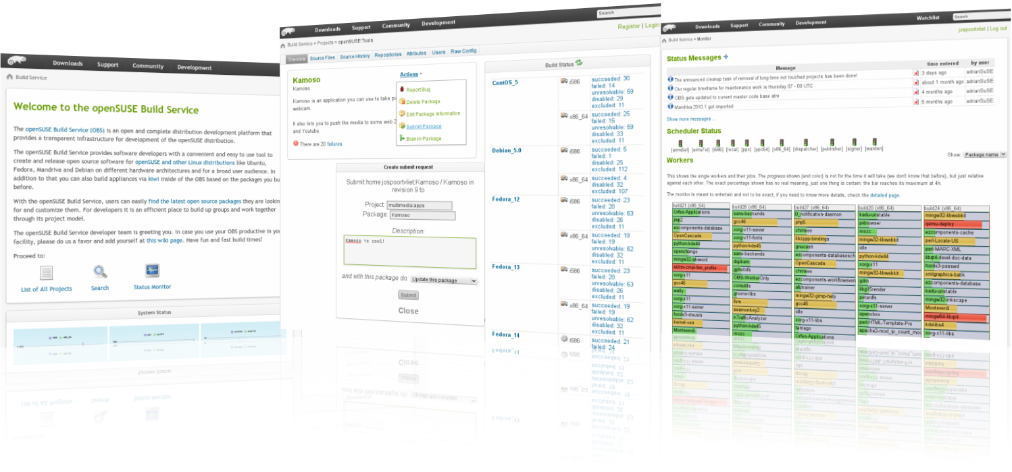
build.opensuse.org
Notes:
Center: Merge request
Right: Build status.
Whole workflow can be done from web ui or commandline – or both.
contribute to openSUSE or build your fedora packages from a windows Netbook or an android phone! :D
Check out build.opensuse.org!

Slide 8

Newcomers welcome
Notes:
openSUSE is always looking for new volunteers
people who actually want to make a difference!

Slide 9

opensuse.org
planet.opensuse.org
opensuse.org/Portal:How_to_participate
opensuse.org/Junior_jobs
features.opensuse.org
build.opensuse.org
openhatch.org
#opensuse-project

Slide 10

Join the gang
Notes:
... come join us and have fun...
Try openSUSE, SUSE Studio, TRY OBS, play with us!

Slide 11
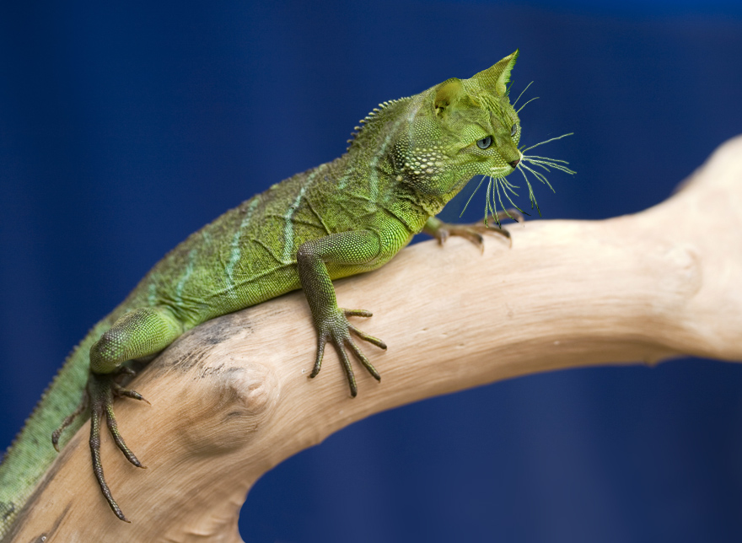
Be a Geeko/Kitten
Notes:
Be the Geeko you can be!

Slide 12
Kitty Image credits
Me: Merlijn Hoek
Hard at work: anzaq78
Newcomers: abcrumly
Join the gang: malingering
Geeko kitten: no idea...
To be found on Flickr under the above names with a Creative Commons license. Thanks all!

Slide 13
Your next Linux Distribution!

